Slide 1
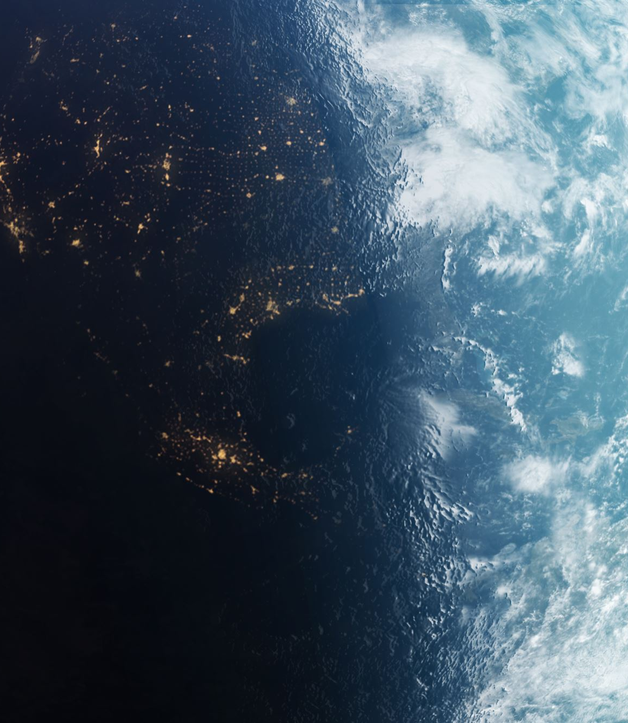
PREDICTION OF SPACESHIP TITANIC’S PASSENGERS TRAVELLING
DIRECTION
Group 3
Vennela Chadalavada(811232432)
Shirisha Avadoota(811227718)
Rohitha Reddy Muppidi(811232522)

Slide 2
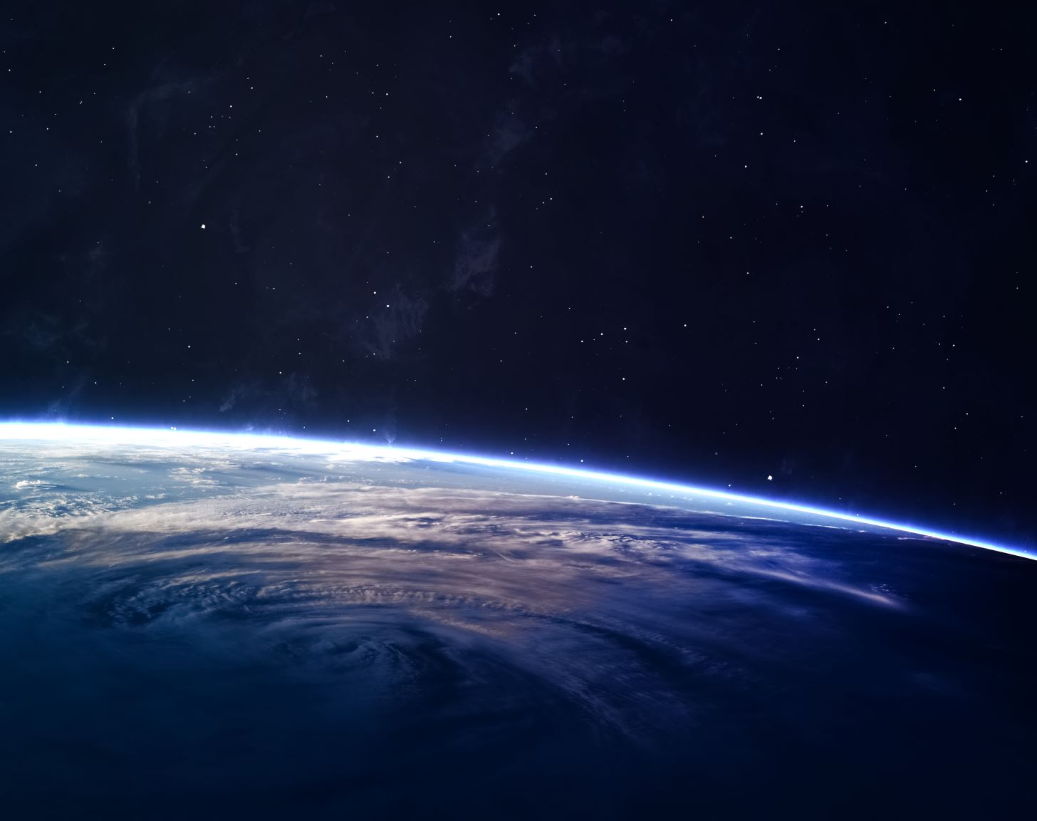
Problem Statement
The Spaceship Titanic was a spaceship that traveled between stars and carried passengers from one planet to another. It can accommodate over 13,000 passengers.
This encountered a spacetime anomaly that was concealed by a dust cloud. The collision disturbed the orbit, sending nearly half of the passengers into a different dimension.

Slide 3
So, the goal is to find the best suitable machine learning algorithm which provides us the better accuracy.
This task statistically corresponds to a classification problem, and we will use a variety of classification approaches and compare the performance outcomes. Classification Accuracy will be used as the basis for performance evaluation.

Slide 4
Milestones:
Milestone 1:
Problem statement , Literature review:
Understanding the problem statement and studying the concepts related to them.
Milestone 2:
Data Analysis:
Exploring the data and analyzing the data in the form of graphs.
Milestone 3:
Algorithms:
We going to consider 5-6 algorithms, Work on them and see which will give us the best result.
Milestone 4:
Final Analysis:
We will consider the top three algorithms when compared to other and tune them to get better accuracy.

Slide 5
Tools and Framework:
Anaconda Navigator
Language: Python
Data Collection:
We have two datasets which are
train.csv
test.csv
We have 8693 rows and 14 columns in the training dataset and 4277 rows and 13 columns in the test dataset.

Slide 6
The above datasets contains 14 fields which are:
- PassengerID - RoomService
- HomePlanet - FoodCourt
- CryoSleep - Shopping Mall
- Cabin - Spa
- Destination - VRDeck
- Age - Name
- VIP - Transported
DATA COLLECTION

Slide 7
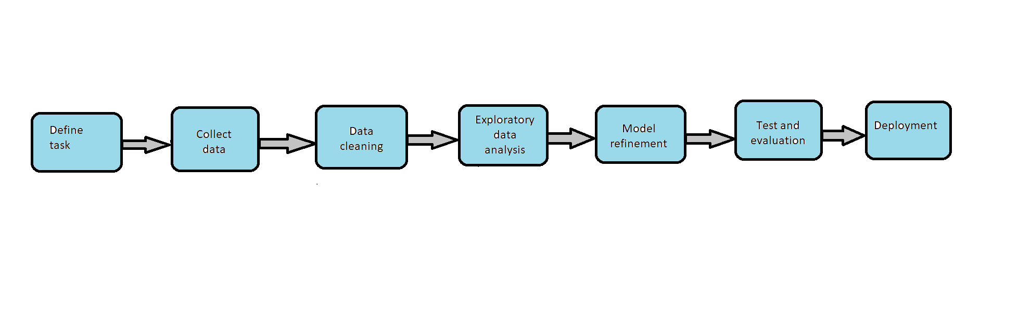
Architecture diagram:

Slide 8
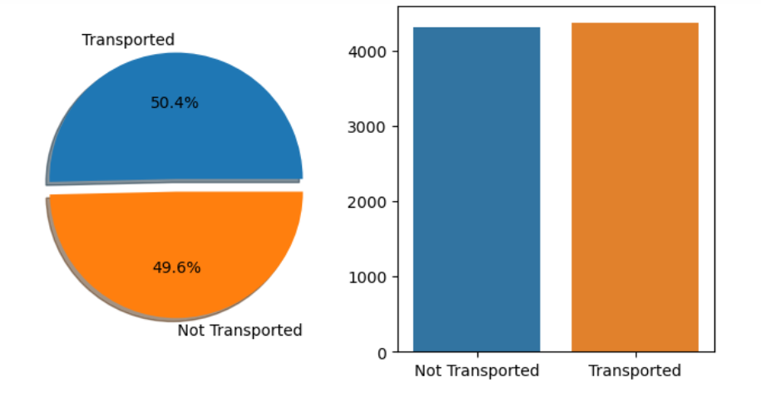
Milestone 2:
From this diagram, we can predict that how many passengers transported to other direction and how many passengers are not transported to other direction.

Slide 9
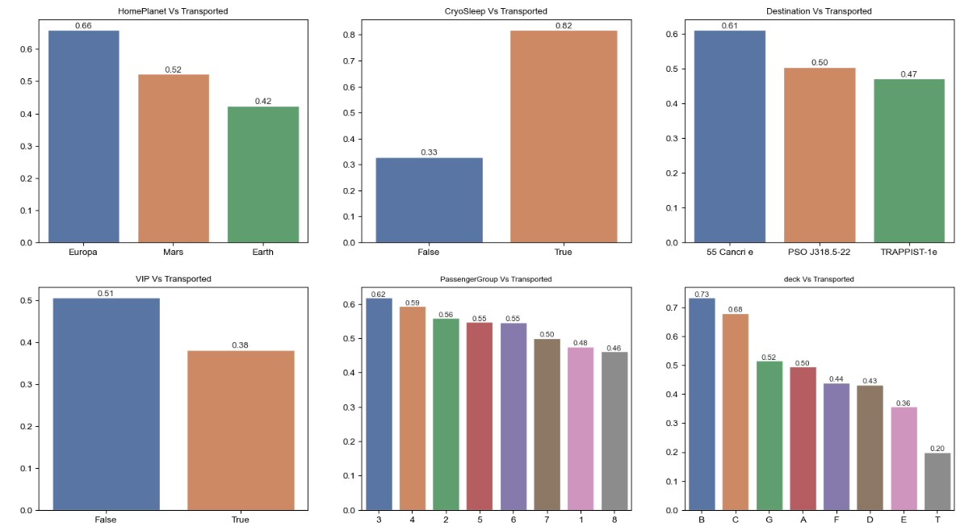
Categorical features with target:

Slide 10
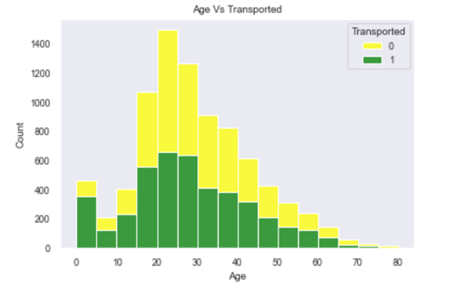
Numeric features with target:

Slide 11
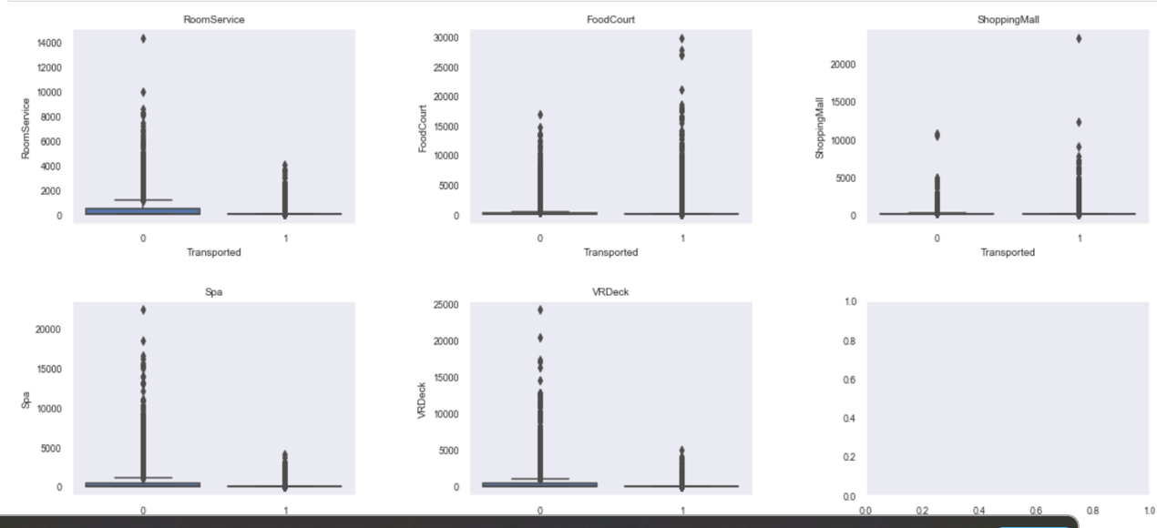
Numeric features with target:

Slide 12
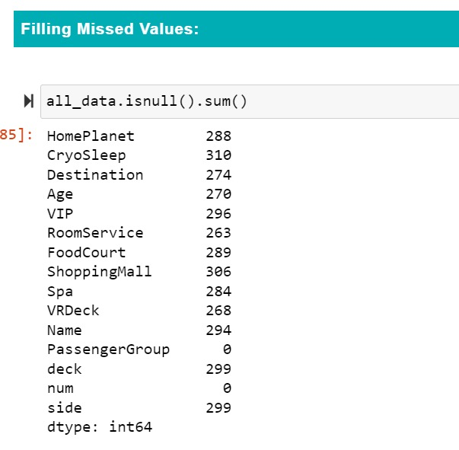
Data Processing
Here we are filling missed values
Firstly, we are going to find the null values and add them up in each field.

Slide 13
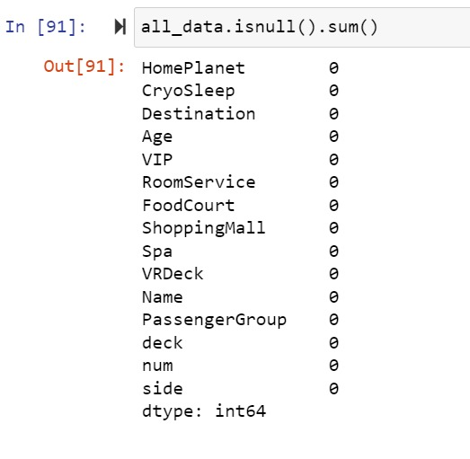
Now, we are going to fill the null values in each field by mode and median.
After this we will check whether the dataset contains null values or not

Slide 14
Data Engineering:
In this step we are going to arrange the data in proper way for analysis which will be used furtherly for model training.
Family size:
From the full name of the passenger, we will be splitting the last name and count the number of passengers who are having same last name and declare them as a family. So that we will be getting the family size.
Money Spent:
By adding all the money spent in all the services provided in the ship such as Room service, food court, shopping mall, SPA, VR deck we will get the total amount spent by a passenger.
Spend Category:
Here we are going to classify the money spent in particular ranges for easy understanding.
Any Spend:
We are checking whether the passenger spent any money or not.
IsChild:
We are checking whether the passenger is child or not by giving a condition as age less than or equal to 10

Slide 15
Preparing for Training:
Here we converting values from boolean to integers.
Lastly, we will print the head values to check whether getting all the fields correctly or not.

Slide 16
The following are the algorithms which we have taken into consideration:
Random Forest
Logistic Regression
K-Nearest Neighbors (KNN)
Decision Tree
Adaptive boosting
Gradient boosting
Extra trees
Milestone 3

Slide 17
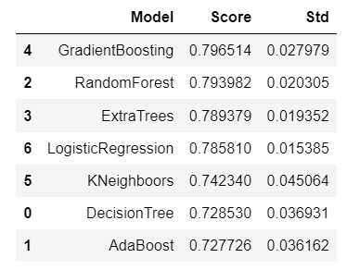
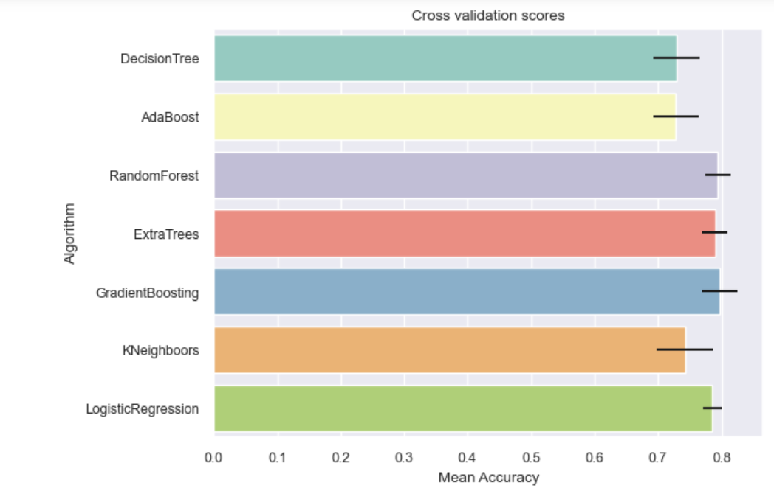
Results:

Slide 18
Milestone 4
We have considered the top three algorithms when compared to others and tuned them to get better accuracy.
The top three algorithms are as follows:
Gradient Boosting
Random Forest
Extra Trees

Slide 19
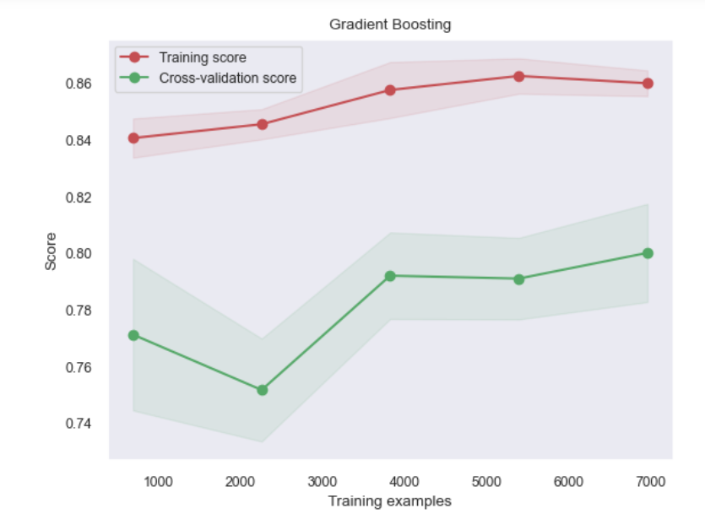
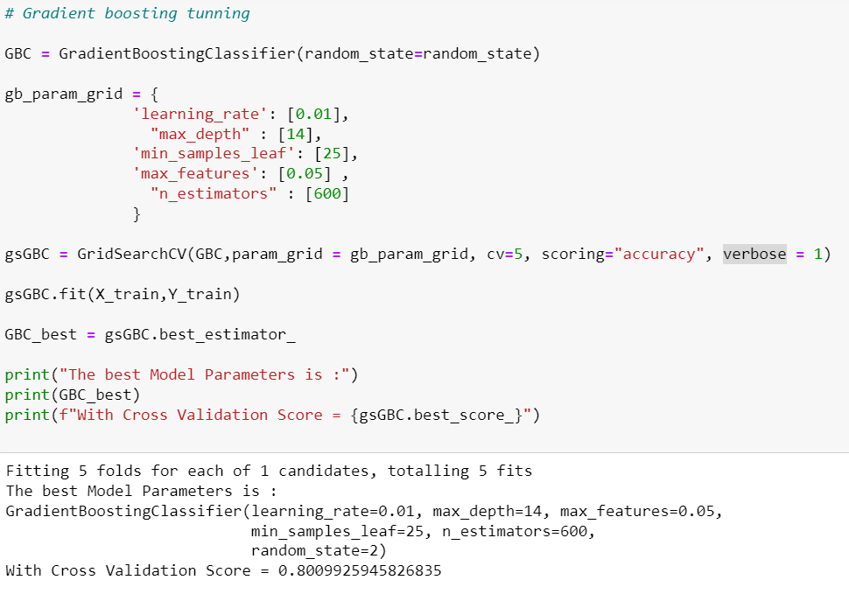
Gradient Boosting

Slide 20
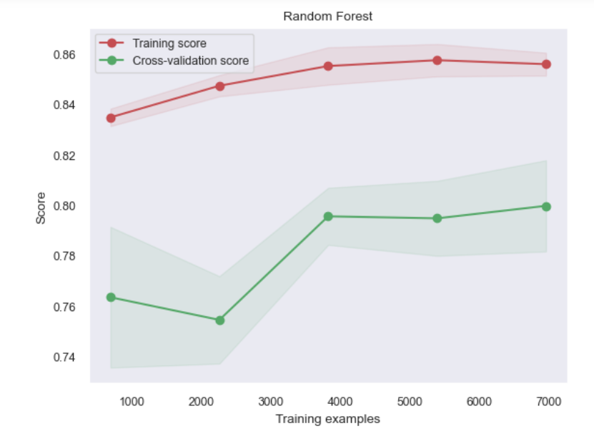
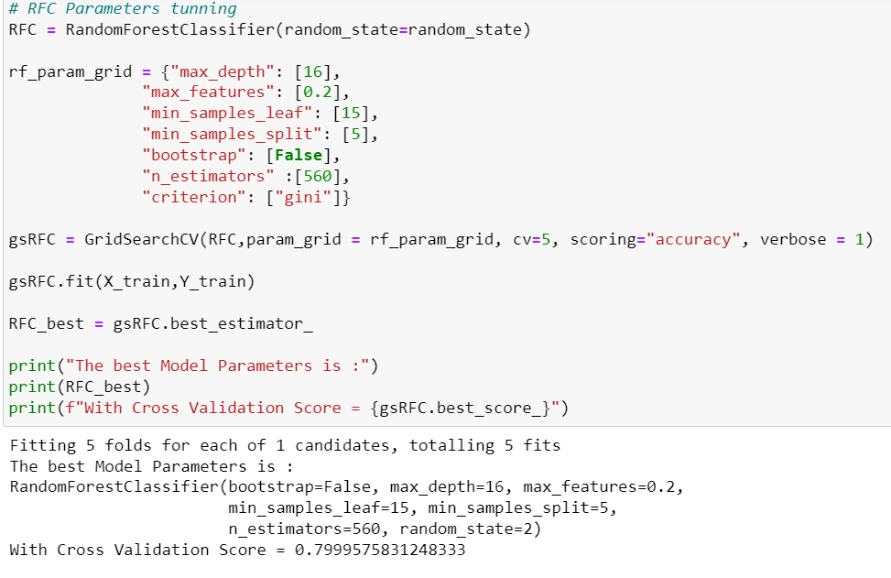
Random Forest

Slide 21
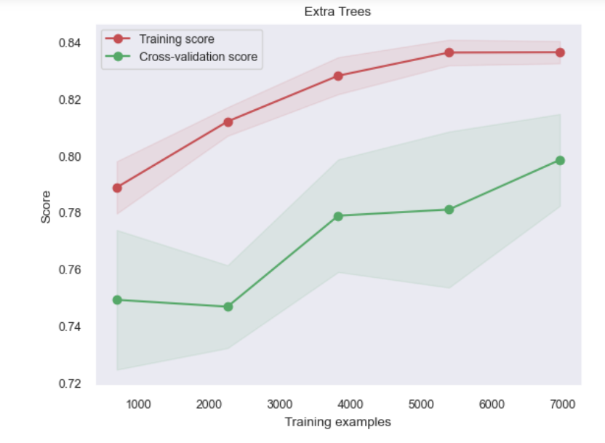
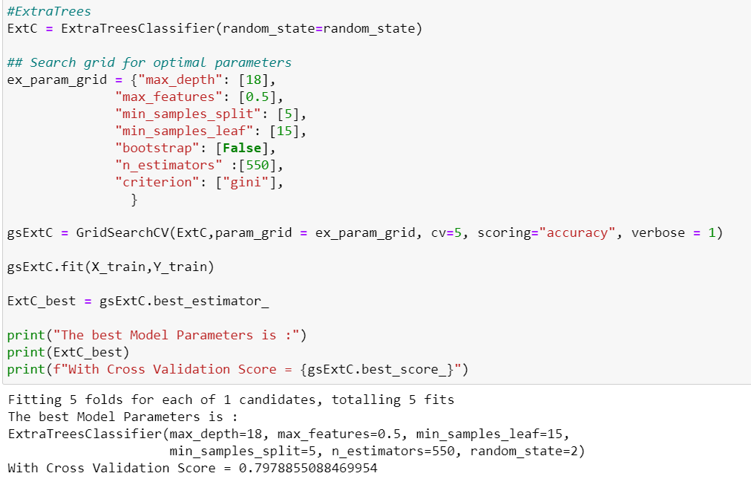
Extra Trees

Slide 22
Conclusion
Finally, after tuning we conclude that the Gradient boosting algorithm is the best suitable algorithm here as we got better accuracy(i.e. 0.80) when compared to other algorithms that we have taken into consideration.

Slide 23
Thank you

